Slide 1
STUDENT NAME: JEGADEESAN G
REGISTER NO AND NMID: 212400943-18AC24112CC1988AB0C46B7FAFCDA6FC
DEPARTMENT: II-BCA
COLLEGE:Prince shri venkesteshwara art and science college/madras university

Slide 2
DIGITAL PORTFOLIO
PROJECT TITLE

Slide 3
AGENDA
1. Problem Statement
2. Project Overview
3. End Users
4. Tools and Technologies
5. Portfolio design and Layout
6. Features and Functionality
7. Results and Screenshots
8. Conclusion
9. Github Link

Slide 4
Problem Statement
Difficulty in showcasing skills, projects, and achievements without a proper portfolio.
Lack of a personalized platform for self-introduction and professional presentation.
Need for a simple and attractive digital portfolio.

Slide 5
Project Overview
A personal portfolio website created using HTML, CSS, and JavaScript.
Showcases About Me, Skills, Projects, and Contact sections.
Responsive, modern, and easy-to-navigate design.

Slide 6
End Users
Students who want to present their work.
Freshers seeking internships or jobs.
Professionals showcasing skills to recruiters.
Anyone wanting an online personal brand.

Slide 7
Tools and Technologies
HTML5 - structure of the portfolio.
CSS3 - styling and layout.
JavaScript - smooth scrolling and interactivity.
VS Code - IDE used.
Browser - for testing and running.

Slide 8
Portfolio Design and Layout
Header/Navbar with logo & navigation.
Hero section title and intro.
About section - personal details.
Skills section technical skills list.
Projects section - project cards with descriptions.
Contact section communication details.
Footer - copyright info.

Slide 9
Features and Functionality
Responsive and modern UI.
Smooth scrolling navigation.
Interactive hover effects on projects.
Organized skill listing.
Minimalist dark theme with highlighted yellow color. ↓

Slide 10
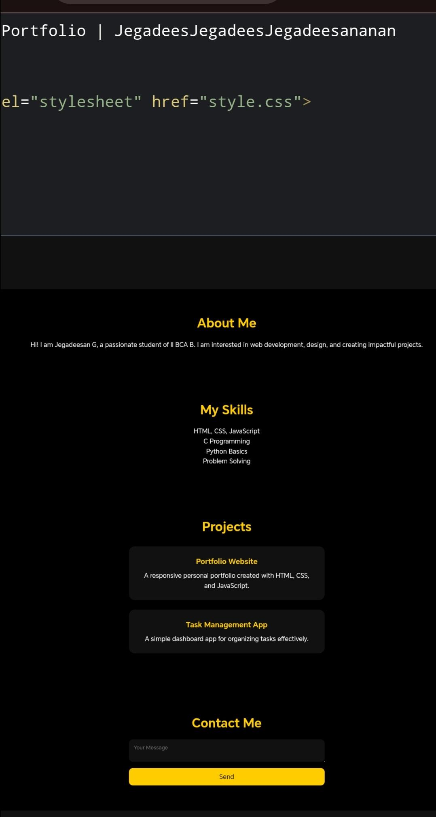
Results and Screenshots

Slide 11
Conclusion
Successfully built a responsive personal portfolio.
Helps in self-presentation and showcasing projects.
Can be extended with backend integration (e.g., contact form, blogs).

Slide 12
Github Link
https://13563bca2024-beep.github.io/TNSDC-FWT-DP-JEGADEESAN/

